Slide 1
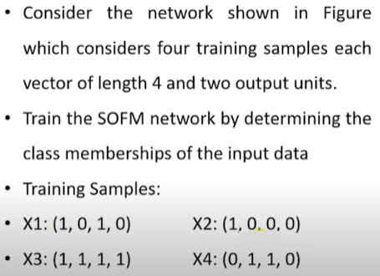
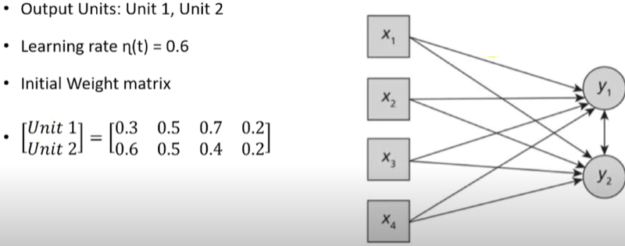
Example (Kohonen Learning Algorithm SOM)
0.3
0.6
0.5
0.5
0.7
0.4
0.2
0.2

Slide 2
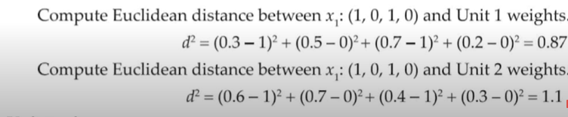
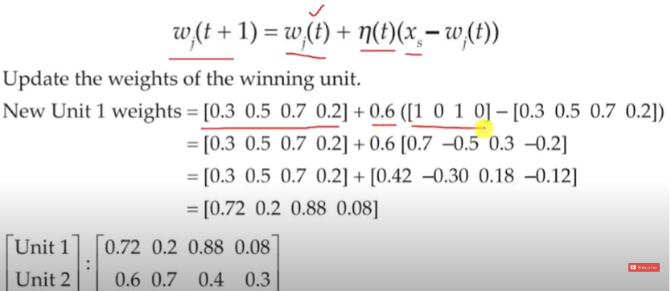
For training example x1 = (1,0,1,0)
Unit 1 wins as 0.87<1.1

Slide 3
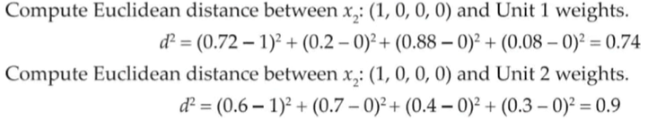
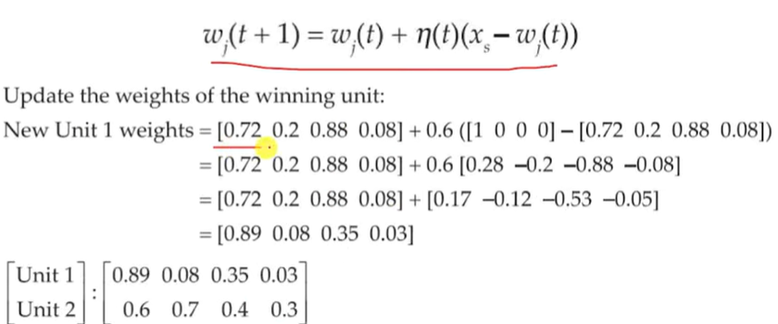
For training example x2 = (1,0,0,0)
Unit 1 wins as 0.74<0.9

Slide 4
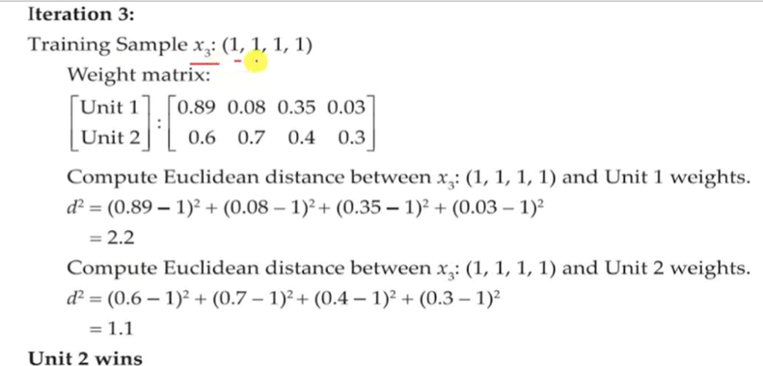
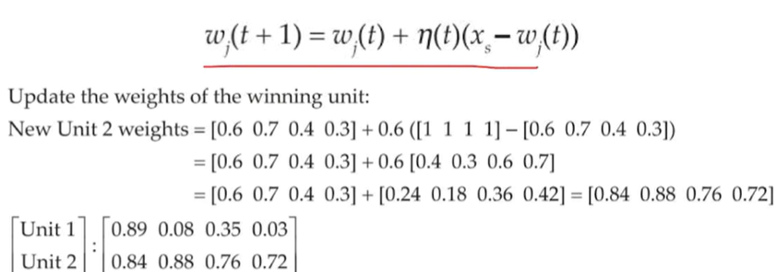

Slide 5
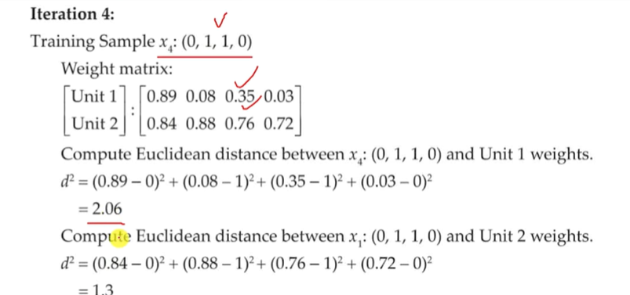
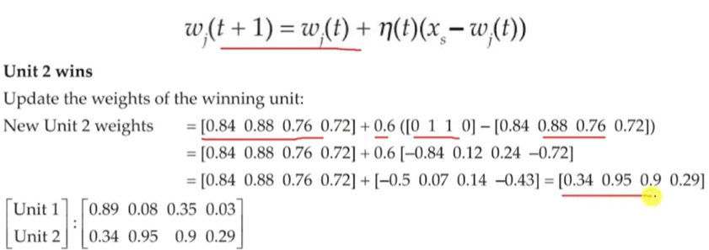
Unit 2 wins

Slide 6
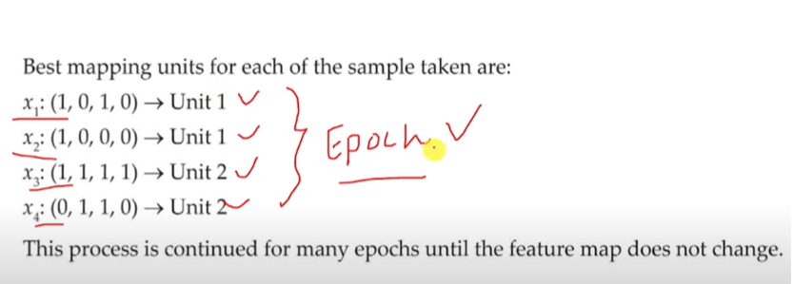

Slide 7
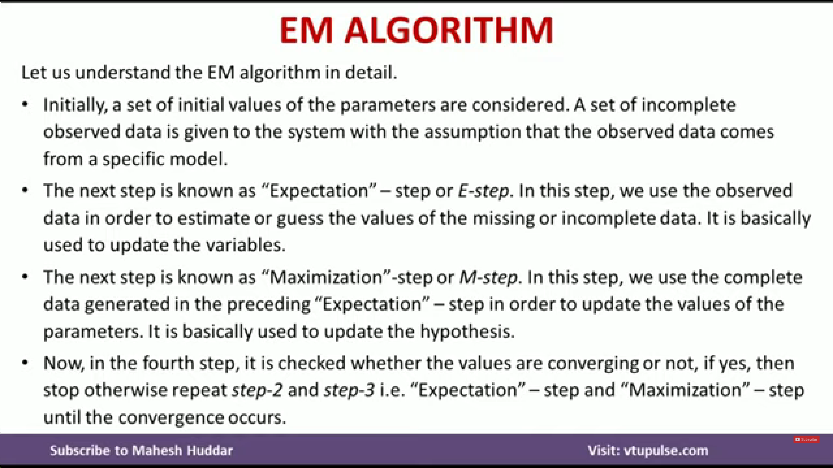

Slide 8
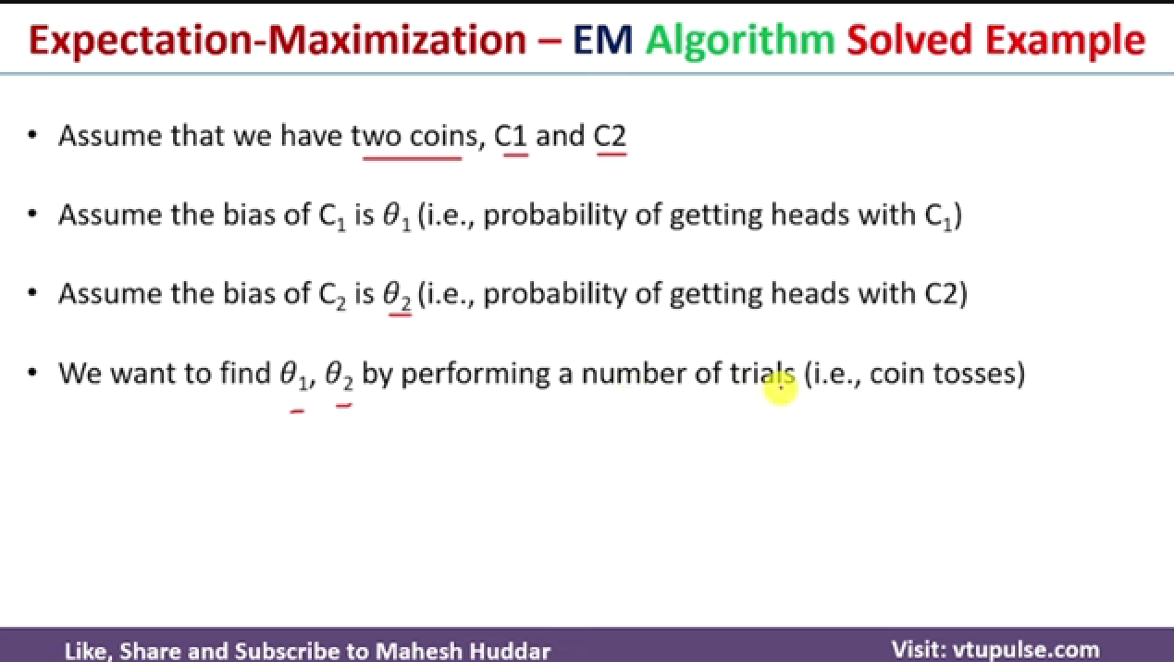

Slide 9
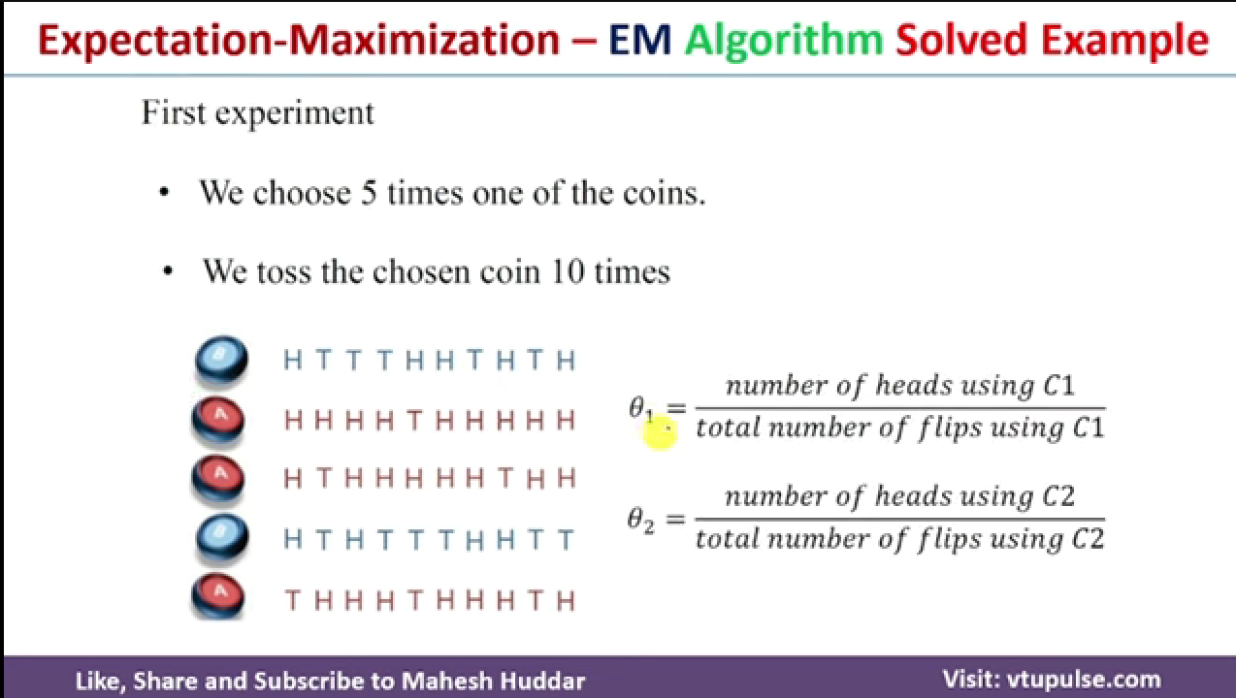

Slide 10
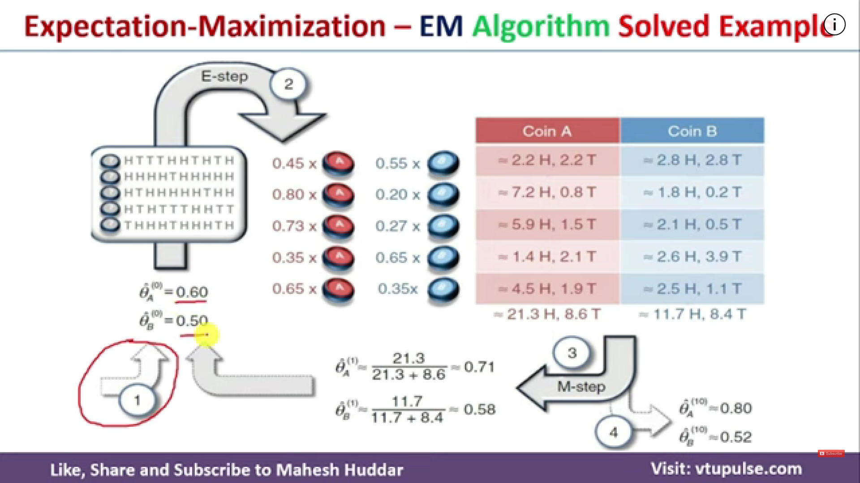
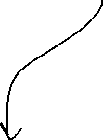

Calculation shown in next slide
Replace θA and θB with 0.71 and 0.58 and repeat until difference bw old θA,θB and new θA,θB becomes 0

Slide 11
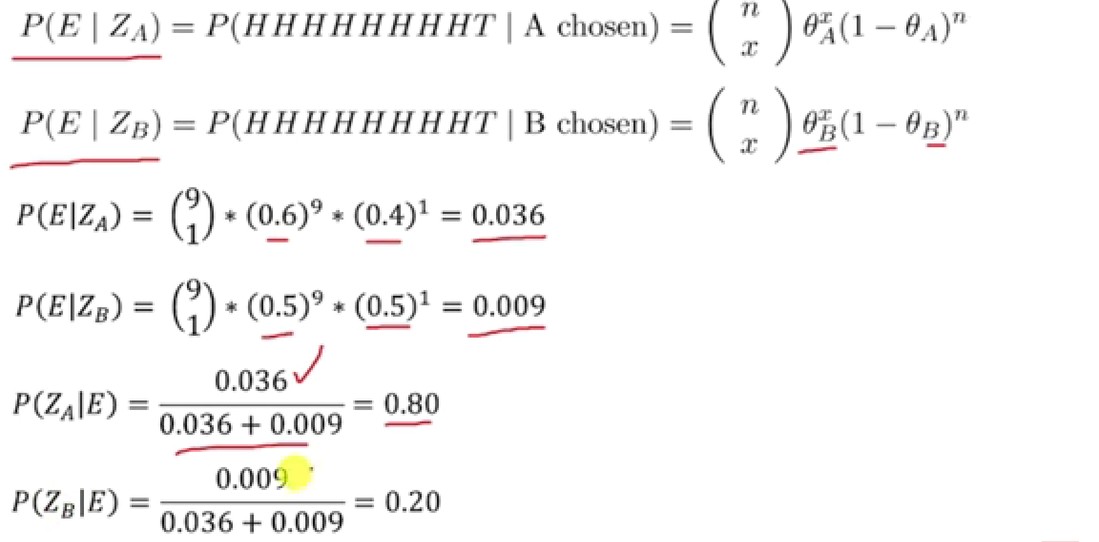
Assume initial values θA = 0.60 and θB = 0.50
Where n = no. of times head and x = no. of tails
Coin A: P(ZA) * n = 0.80 * 9 = 2.2H, P(ZA) * x = 0.80 * 1 = 0.8T
Coin B: P(ZB) * n = 0.20 * 9 = 2.8H, P(ZB) * x = 0.20* 1 = 2.8T

